Slide 1
The Concept of Modern American
Tragic Hero

Slide 2
Presented by
Noha Al-Absi
Heba Al-Amri
Maram Al-Satti
Fatimah Al-Solami

Slide 3
Going to:
1-Meaning of tragic hero2-Characteristic of classic tragic hero
3-Examples of classic tragic hero
4-Modern American tragic hero
5-Characteristic of modern tragic hero
6-Examples of modern tragic hero

Slide 4
What is a tragic hero?
-The idea of the tragic hero was created in ancient Greek tragedy and defined by Aristotle (and others).
-The tragic hero is a man of noble stature. He is not an ordinary man, but a man with outstanding quality and greatness about him. His own destruction is for a greater cause or principle

Slide 5
Common characteristics of a tragic hero:
-Usually of noble birth - Hamartia: the tragic flaw that eventually leads to his downfall. - Peripeteia - a reversal of fortune brought about by the hero's tragic flaw - His actions result in an increase of self- awareness and self-knowledge - The audience must feel pity and fear for this character
-

Slide 6
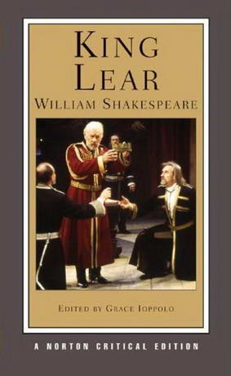
Examples of Tragic Hero:

Slide 7
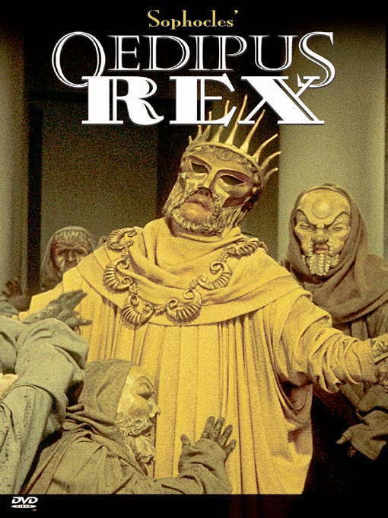
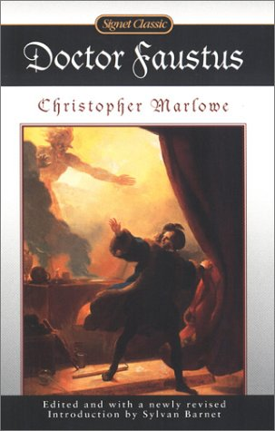

Slide 8
Modern American tragic heroes
-In the Modernist era (late 19th and early 20th century), a new kind of tragic hero was created out of a result of this "classical" definition.
-Modern playwrights have continued to create characters whose tragic flaws lead to tragedy, but these are not usually heroes in the classical sense.

Slide 9
characteristics of modern American tragic hero:
-The modern hero, it seems, does not necessarily have to be of a high estate - but rather an "ordinary person".
-The story may not result in an epiphany of awareness or even come to a resolution of catharsis.
-The story may end without closure and even without the death of the hero. This new hero of modernism is the antihero and may not be considered by all to even be a tragic hero.

Slide 10
Examples of Modern American Tragic Hero

Slide 11
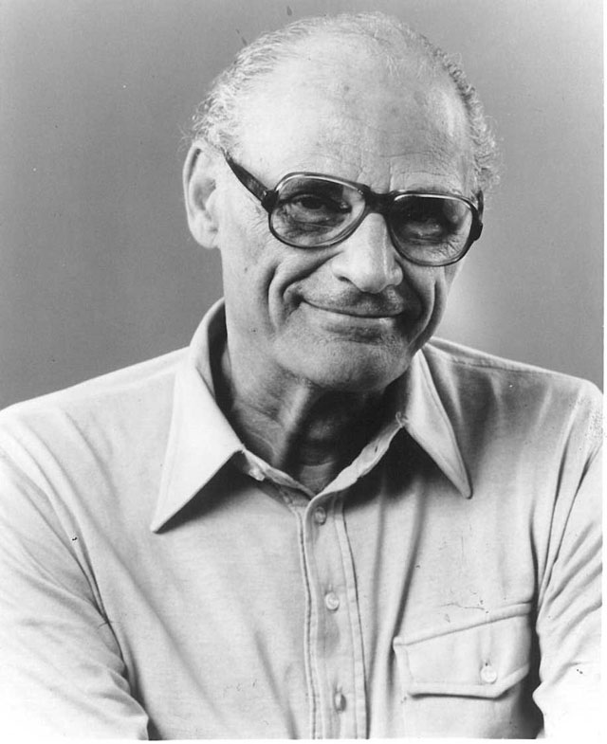
-Arthur Miller stands out as a successful writer of tragic plays. He wrote the tragic play "Death of a Salesman“.
-In the story, the main character supports the qualities of a modern tragic hero.
Arthur Miller

Slide 12
-Willy Loman is a tragic character. This is because Willy Loman has the following attributes: ”, a tragic character is presented as a victim of society or in other words a common man; where "a sense of triumph is evident even if the character dies - someone benefits" and a tragic flaw which leads to Willy Loman's downfall.

Slide 13
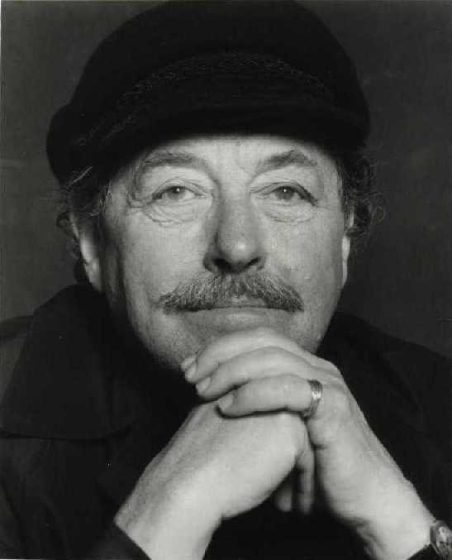
1- A Streetcar named desire written by Tennessee Williams.
-Is a play about a fallen woman in society’s eyes.
Tennessee Williams

Slide 14
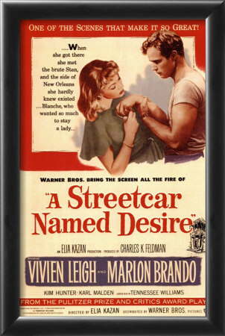
-As a young woman Blanche lost the family fortune, estate and her young husband. These events have overwhelmed Blanche for years causing her to be a social exile. She is sometimes described as a tragic hero; a person who once had vast potential was plagued with a doubtful future.

Slide 15
-Others believe that Blanche Dubois is an anti-tragic hero, meaning that her life had no significance and effect on society. The Southern belle known as Blanche demonstrates throughout the play that her life did not make an impact on the world, in the end she was only fooling herself.

Slide 16
Thank You

