Slide 1

Pink Emerald
Abrar Al-Harthi
Basma Sawadi
Rana Al-Ghamdi
Rogaiah Al-Yaba
Samar Sulimani

Slide 2
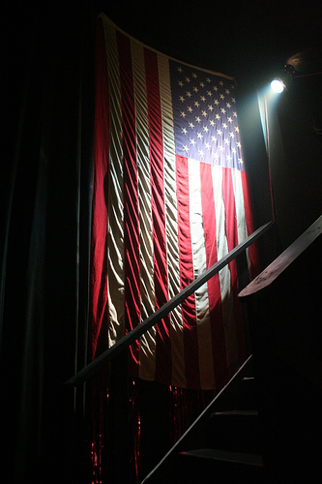
The Modern
American
Theatre

Slide 3

The American History
At the beginning, as the English settled along the
Atlantic coast of America, there were important
differences between
Southern
The New England

Slide 4
The American History
Southern
aristocracy
Develop a literature their own
The New England
A strong sense of unity and “shared purpose”
Puritans were fighting against the English
Formed a society based on strict Christian beliefs
Rich and powerful

Slide 5
The History of the
Theatre in America
It begins early in the Eighteenth Century, about the time the first rumblings were heard of the storm which was to break the ties still holding the Colonies to the mother country.
During the 20th century especially after World War I, Western drama became more internationally unified and less the product of separate national literary traditions.

Slide 6
American theatre is very diverse, it contains many different styles of theatre that includes traditional theatre in the form of Shakespeare plays, but it also extends out as far as the modern Broadway musicals.
All of these different forms of theatre have common similarities however that were inherited from the past.
One of the major developments of modern theatre is the location of a central theatre “Mecca” in New York City.

Slide 7
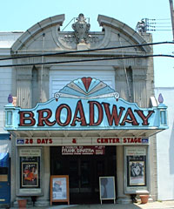
Broadway Theatre
The development of Broadway, especially in the early 1900s made it one of the most prominent areas of theatre culture in the world. Broadway brought out a new culture to theatre because it created “theatre as art” to a new level; it also brought social distinction between classes.

Slide 8
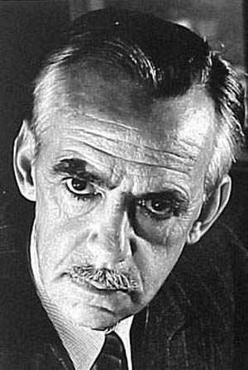
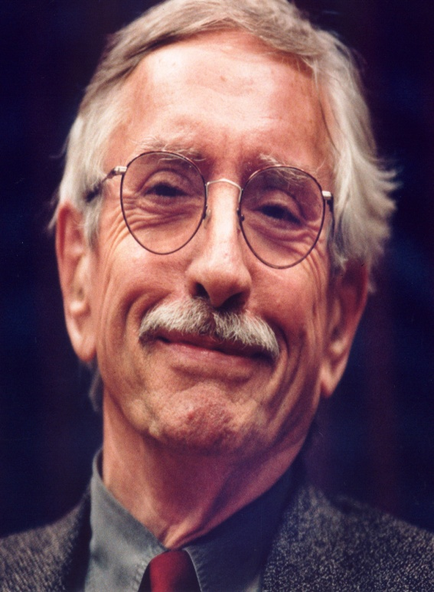
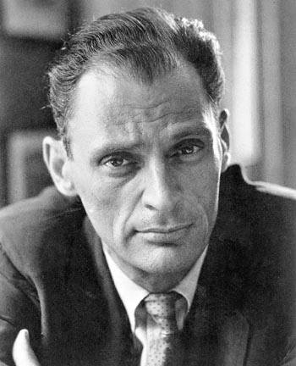
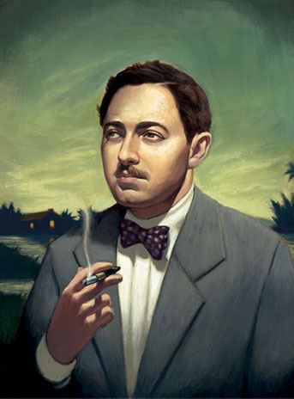
The Famous playwrights
and
Their Works

Slide 9
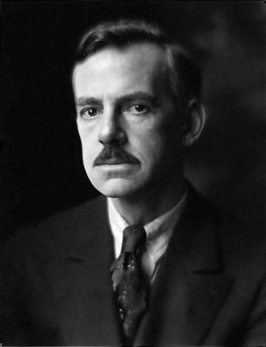
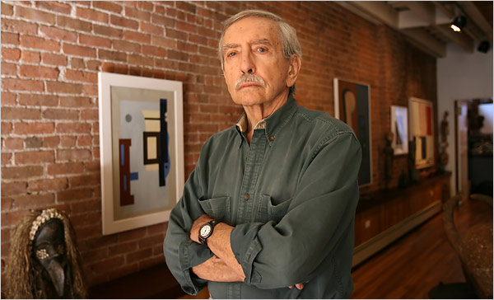
Eugene O'Neill (1888-1953)
Arthur Miller (1915-2005)
Tennessee Williams (1911-1983)
Edward Albee March 12, 1928

Slide 10
Eugene O'Neill
(1888-1953)
With O’Neill, American drama developed into a form of literature.
He freed it from the character types of melodrama (the ' pure' heroine, the kindly old father, etc).
Through his many plays he brought a wide range of new themes and styles to stage.

Slide 11
Eugene O'Neill
(1888-1953)
Each play is an exploration on human condition.
In 1936, O'Neill won the Noble Prize for Literature.
His plays are among the first to introduce into American drama the techniques of realism.
O'Neill chose a style employing distortion and fragmentation for themes of industrialism and alienation.
Long Day’s Journey into Night is the best known play.

Slide 12
Arthur Miller
(1915-2005)
Miller combined in his works social awareness with deep insights into personal weaknesses of his characters.
Miller's plays continued the realistic tradition that began in the United States in the period between the two world wars.
He married the actress Marilyn Monroe.
His best known play is Death of a Salesman(1949).
“Death of a Salesman,” came to symbolize the American Dream gone awry.

Slide 13
Tennessee Williams
(1911-1983)
Tennessee Williams received many of the top theatrical awards for his works of drama.
He moved to New Orleans in 1939 and changed his name to "Tennessee", the state of his father's birth.
The ‘mad heroine’ theme that appears in most of his plays seem to be influenced by his sister Rose.
He best known for A Streetcar Named Desire.

Slide 14
Edward Albee
March 12, 1928
His works are considered well-crafted, often unsympathetic examinations of the modern condition.
His early works reflect a mastery and Americanization of the Theatre of the Absurd that found its peak in works by European playwrights such as Jean Genet, and Samuel Beckett.
Albee continues to experiment in new works, such as The Goat: or, Who Is Sylvia? (2002).
He best known for Who's Afraid of Virginia Woolf?.

Slide 15
The Emergence of the Modern American Theater, 1914-1929
Ronald Wainscott
Professor of Theatre and Drama and Director of Graduate Studies
at Indiana University
He is interesting in Theatre history, dramatic literature, American theatre and drama from 1890. He also presents, history of directing, European theatre and drama from 1912-1945.
Wainscott explores the emergence of the modern American theater in New York during a turbulent era of clashing artistic tastes and conflicting cultural, economic, and political events.

Slide 16
He provides the first complete historical and cultural examination of the period.
He deems Broadway theatre the most prolific and influential.
He offers an immense trove of material on plays and productions from 1914 to 1929.
In his book (The Emergence of the Modern American Theater, 1914-1929), he goes on to investigate the theater-tax rebellion of 1919, the role of women in popular sex farces, censorship battles over changing themes and language.

Slide 17
A spatial aspects of American expressionism, popular drama’s treatment of commercialism, and theatrical responses to the Russian Revolution.
He shows how dynamic theatrical experiments altered definitions of serious play righting, stage direction, and scenic design.
Wainscott deals with such notable figures as Eugene O’Neill, Maxwell Anderson, Susan Glaspell, Sophie Treadwell, Arthur Hopkins, Robert Edmund Jones, Lee Simonson, and Philip Barry.
He is the author of Staging O’Neill: The Experimental Years, 1920–1934, published by Yale University Press.

Slide 18
Characteristics of Modern Drama
Psychological and spiritual displacement
Loss of connections
Loneliness
Self deception
Realism
They used those themes to speak to a world in which the individual had been cut loose from ;
The traditional "anchors" of religion
Socio/political alignments
Family relationships
Defined self-image
They confronted the problem of mechanized society by ;
Laying human passions
Exposing the raw tensions of the American family
Challenging Victorian/Puritan morality

Slide 19
Southern group
The Southern group of writers such as William Faulkner, Flannery O’Connor, and Robert Penn Warren would build many of his themes around ;
The invading materialism of the reconstructed South Such themes required fresh designs in form ;they highlight formal/stylistic characteristics for us through:
The shocking extensive of overstatement
The ambiguity of images and symbols
The heartbreak tone of understatement
The new heroic image
The innovative patterns of visual art
Layers of the inner self
The duality (two parts) of "anima" and "persona“
The delusions (false belief) of neuroses
The power of association and simultaneous experience in
stream of consciousness ; provided ideas for provocative structural patterns.

Slide 20
American dramatists such as Eugene O’Neill, Arthur Miller, and Tennessee Williams crafted forceful statements in these Characteristics of Modern Drama.
Note..

Slide 21
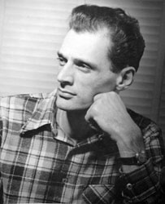
“The American Dream is the largely unacknowledged screen in front of which all American writing plays itself out," Arthur Miller has said .

Slide 22


