Slide 1
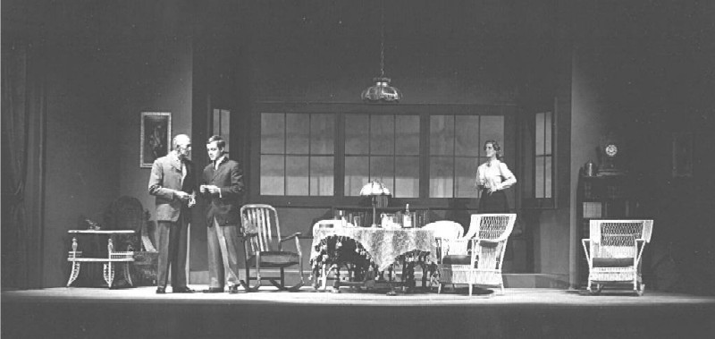
Amal AL-Lebdi
Bedoor AL-Motairi
Reem Mohammad
Sara AL-Shaffee
Marwa AL-Shaikh

Slide 2
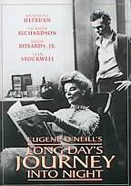
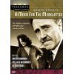

EUGENE O’NEILL’S. Long day’s journey by

Slide 3
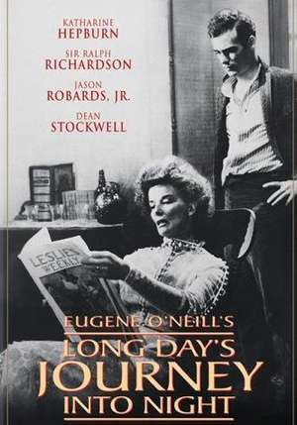
“O'Neill's dramatic devices in Revealing the Past and his New Techniques of Expression”

Slide 4
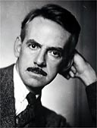
“O'Neill's Technique”

Slide 5
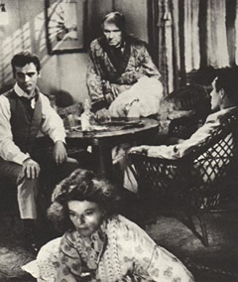
Dialogues

Slide 6
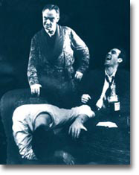
Dialogues
For the most part, the play is written in straightforward, realistic dialogue. The characters talk with the speech patterns of their day. O'Neill, however, doesn't seem to be satisfied with mimicking every day speech. This leads to a good amount of poetry in the play. Besides the numerous direct quotes from other poets, O'Neill infuses much of the dialogue with a poetic sense. Edmund's speeches in Act IV are probably the best example.

Slide 7
Edmund’s dialogue with his father in act 4 is very important because he understands his father now better than he ever has. He talks to his father about his days sailing, and talks indirectly about his hopes to be a great writer. The conversation between Edmund and Jamie is the second vital conversation of the play.

Slide 8
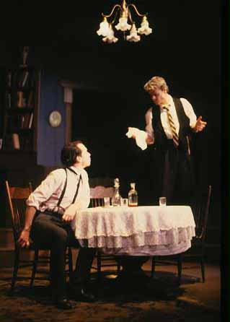
Jamie's confession is a powerful moment when he confesses that he wants his own brother to fail. The play has little in the way of plot, but if it can be said to have a climax, that climax is Edmund's forgiveness of his brother and father. It is because of this climax that Edmund emerges as the play's central character.

Slide 9
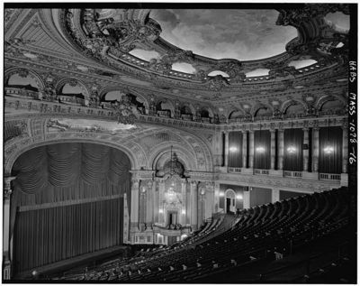
Stage Directions

Slide 10
stage directions
The stage direction is a very important technique in this play . The stage direction are a way to help the audience to see the characters as O'Neill visualized them . The stage directions reflect O'Neill's realistic view of his characters .

Slide 11
stage directions
O'Neill makes extensive use of stage directions because the play is meant to be read as much as it is meant to be performed. O'Neill's stage directions give directors strong insights into how to interpret the work; they also make the play able to stand up well as a piece of text. the stage directions describe the four central characters, inform readers that the Tyrone family is well educated by showing the books look well-used.

Slide 12
Irony
The play's final words are hers, irony in her words: "I fell in love with James Tyrone and was so happy for a time.". Finishing in this way indicates that despite Edmund's triumph, not everything has been resolved. Although Edmund has forgiven his family, he cannot save them, nor can he force them to forgive each other.

Slide 13
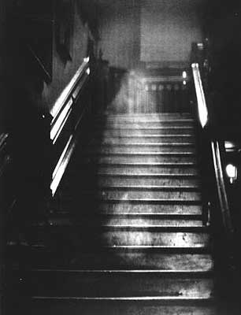
Ghost Imagery

Slide 14
Ghost Imagery
At the end of the act3 , Tyrone warns his wife that she'll be mad as a ghost if she continues. The word is not accidental: metaphorically, she's a phantom. She wanders around the house, detached from the world of the living, isolated and constantly reliving past moments.
Also, Edmund speaks to his father in act 4 about his feeling of being in the fog; he feels like a ghost who drowned long ago, wandering in the mists, and he likes the feeling.

Slide 15
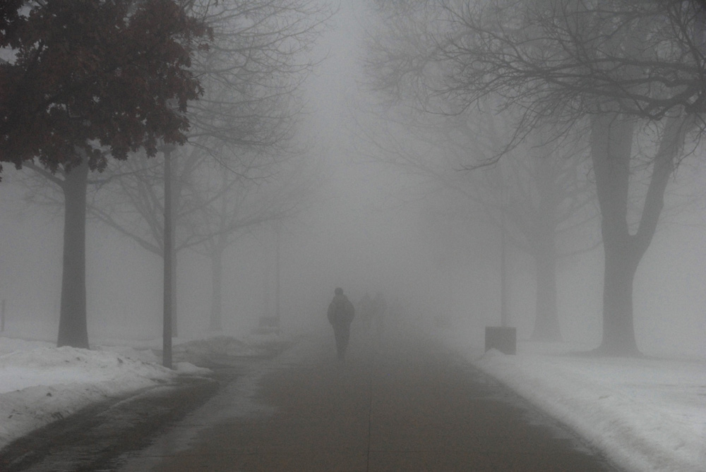
Fog

Slide 16
Fog
Fog can represent a number of different things (estrangement, retreating into one's self, blindness) in Long Day's Journey, but generally, for all of the characters, fog is dark, isolating, and unstoppable. Both Edmund and Mary attempt at various moments to escape or transcend reality, and both use fog as a metaphor or mechanism for doing so.

Slide 17

Morphine and Alcohol

Slide 18
Morphine and Alcohol
Alcohol and morphine function (as drugs often do in literature) as symbols of retreat. Basically, no one in the family has anywhere to go – literally or metaphorically – so they have two options: fight or flight. They fight often (especially the male characters), but they also spend a lot of time fleeing, turning to drugs and alcohol to hide from reality.

Slide 19

Day and Night

Slide 20
Day and Night
The progress of day to night is one of the central symbols of Long Day's Journey. The Tyrone family is caught in a similar cycle. They attack each other, they say something mean, they feel bad, they apologize…it's the family feud that never ends. The whole play is built around these cycles.

Slide 21
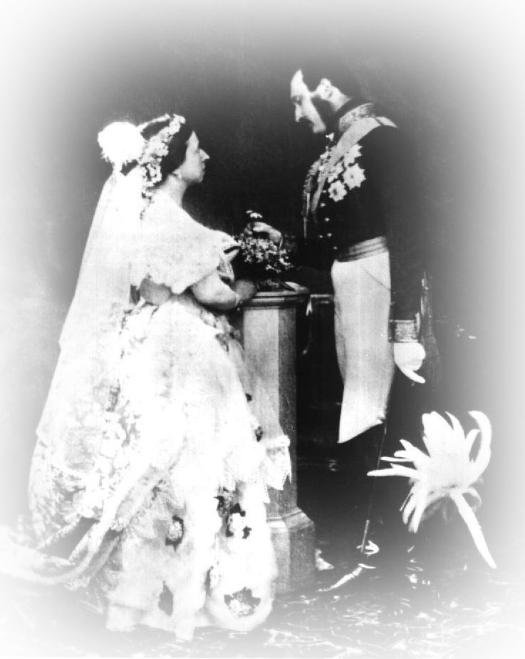
The Wedding Dress

Slide 22
-The wedding dress is a symbol: it represents lost promise and lost happiness.
-The light is symbol in act 4 . the lights are all on during this conversation between father and son. Edmund and Tyrone come to understand each other, to see each other, better than they ever have before. At the end of the .conversation, the lights are turned off again

Slide 23
The Wedding Dress and Booth's Praise
Both of the Tyrone parents have a carefully hidden object that they used to look at every once in a while to remind themselves about what they've lost. Mary's wedding dress brings to mind her happiness with her father, innocence, youth, beauty – what you will. James keeps a piece of paper printed with praise from famous actor Edwin Booth of James's performance of Othello. The dress and the paper each stand in for a history that's dead to the Tyrones, leading to the loss of the objects themselves.

Slide 24
Past Devices:
Illusion(denial) : Marry doesn't like to speak about her problems with addiction, but Edmund thinks that confronting the past will help her.
- Past is represented through her dialogue with her husband . She says that she lost many friends when she married Tyrone, because he was an actor. Also, she had a baby between Jamie and Edmund, Eugene, who died. Edmund was born in part to replace Eugene.

Slide 25
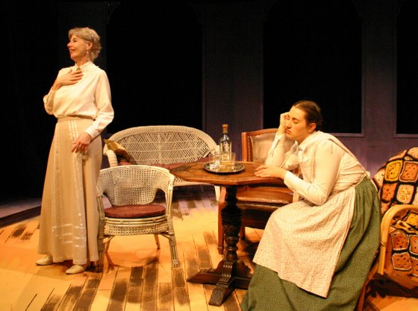
Flashback: Mary remembers some moments from the past in act 3 when she complains to the maid about some of Tyrone’s faults. Mary speaks about her youth. She used to want to be a nun. Her other dream was to be a concert pianist. Mary also remembers meeting Mr. Tyrone, and how in love she once was. Brief touching moment of tenderness between Mary and Tyrone in act 3 speaking about their love in the past.

Slide 26
Now that he is retired, he is still acting, telling Mary that Edmund is in good health when he is suffering from tuberculosis. He fears that if he tells her the truth, she will resurrect another ghost of the past, her morphine habit. Eventually, of course, she does relapse into her old habit.

Slide 27
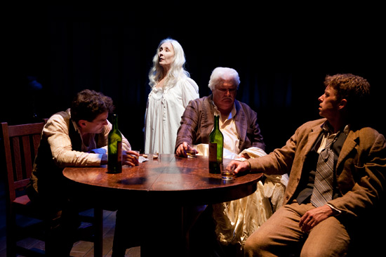
Paradox: Present -Past :
Paradox is a controlling figure of speech in the play in that the past seems to control the present—or, in a manner of speaking, is the present. For example, Mary Tyrone continually dwells on the past—in particular, the fact that she could have been a nun or a concert pianist. At one point, she remarks, “The past is the present, isn’t it? It’s the future, too.

Slide 28
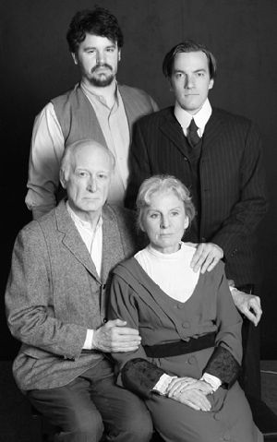
Thank You

