Slide 1
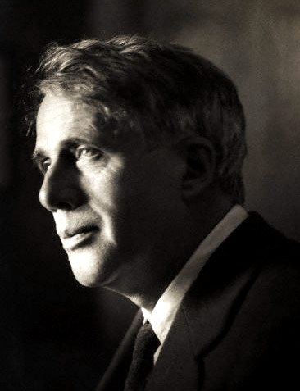
Robert Frost

Slide 2
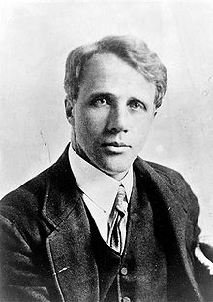
Introduction
*Robert Lee Frost is the only poet to receive four Pulitzer Prizes for his work.
*He also received many honorary doctoral degrees, although he never actually earned a bachelor’s degree.

Slide 3
*An avid teacher and a gifted writer, he is one of America’s most admired poets of the Twentieth Century.
*He wrote in traditional poetic forms but with a twist--capturing the rhythms and vocabulary of ordinary speech

Slide 4
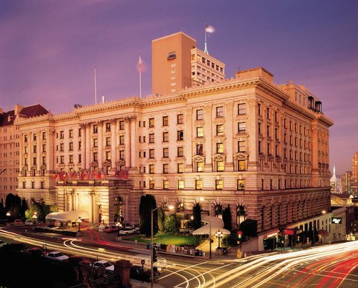
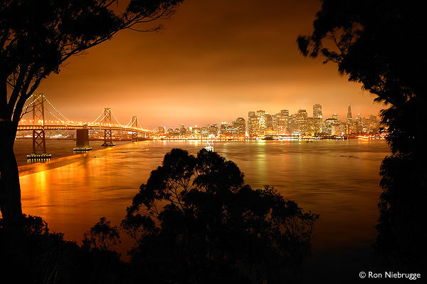
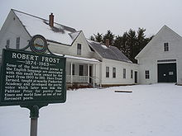
His Life
*Frost was born March 26, 1874 in San Francisco, California. When his father died during his childhood, he moved with his mother and sister to Massachusetts.
*Robert Frost's personal life was plagued with grief and loss.
*Frost died January 29, 1963 in Boston, Massachusetts

Slide 5
His Style
*Frost started writing poetry at the end of the 19th century in the late Victorian period.
*Frost’s work is noted for its conversational style and tone. In fact several of his poems are written as dialogues.
*Frost developed his own theory of poetry, which is reflected in his verse and teaching.
*Frost’s goal was to use the everyday rhythm of speech in verse.
*He rejected the stilted patterns and rhymes of the 19th century poets.

Slide 6
*He also did not care for free verse in which there is no rhyme or meter.
*Frost found beauty in nature and used it in his poetry, yet he understood its power and its potential for tragedy and disaster.

Slide 7
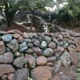
Many of his poems have humor, and center on individuals as they interact with nature.
In one famous example, the "Mending Wall," he used a situation of repairing a wall between two farms, a situation common to the farm life of New England, to convey an idea which he believed held true in the life of all people.

Slide 8
*This was typical of his poetry throughout his life and reflects his belief that poetry should contain contrasts and lead to a clarifying of experience.
*His poetry reflects a dark side, yet reveals a strong faith. He often employed a narrative style in his verse.

Slide 9
Frost's most famous works
*Frost is most remembered for Stopping by Woods on a Snowy Evening and The Road Not Taken.
*Other famous works are Fire and Ice, Nothing Gold Can Stay, Birches, After Apple-Picking, The Death of the Hired Man, Home Burial, and Mending Wall.

Slide 10

Thank You

Slide 11

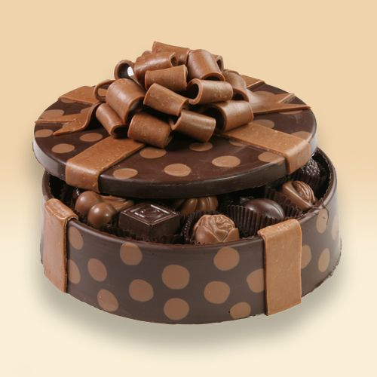

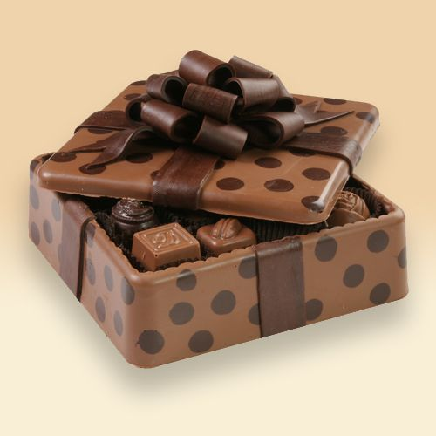
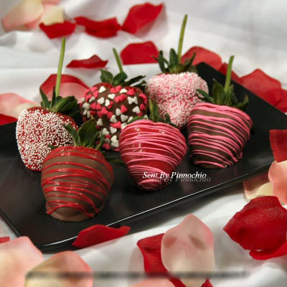
Done by:
Maram Al-Satti
Fatima Al-Solami
Noha Al-Absi
Heba Al-Amri
Noof Al-Otaibi

